Slide 1
Майкрософт и открытость
Стандарты, интероперабельность и интеграции с СПО
Леонид Аникин
Open Source Strategy Lead. Microsoft Russia.
Notes:
< Note to Presenter : Please add your name and email address as appropriate >

Slide 2
Linux Foundation. Annual Linux Development Report, 03/04/12 Основные выводы этого года: § More than 7,800 developers from almost 800 different companies have contributed to the Linux kernel § Seventy-five percent of all kernel development is done by developers who are being paid for their work. § The top 10 organizations sponsoring Linux kernel development since the last report (or Linux kernel 2.6.36) are Red Hat, Intel, Novell, IBM, Texas Instruments, Broadcom, Nokia, Samsung, Oracle and Google. § For the first time, Microsoft appears on list of companies that are contributing to the Linux kernel. Ranking at number 17.

Slide 3
За последние 5 лет Майкрософт изменилась как компания и стала более открытой

Slide 4
Открытые стандарты. Интеграция с СПО.
Сотрудничество с другими игроками
Миграция в облако
Notes:
Я хочу рассказать про открытость в Майкрософт через три перспективы:
Использование открытых стандартов и интеграция с СПО
Платформа Майкрософт и другие технологии
Переход в облако. Облако Майкрософт будет тоже открытым.

Slide 5
Поддержка стандартов
Notes:
Like most vendors, Microsoft invests in significant support for standards.

Slide 6
AIIM (Association for Information and Image Management)
ANSI (American National Standards Institute)
ATIS (Alliance for Telecommunications Industry Solutions)
ATSC (Advanced Television Systems Committee)
CalConnect (The Calendaring & Scheduling Consortium)
CCSA (China Communications Standards Association)
CIPA (Camera Imaging Products Association)
DAISY (Digital Accessible Information System Consortium)
DLNA (Digital Living Network Alliance)
DMFT (Distributed Management Task Force)
DTLA (Digital Transmission Licensing Administrator)
DVB (Digital Video Broadcasting)
DVD Forum
ECMA International
ETSI (European Telecommunications Standardization Institute)
The Green Grid
GSMA (the GSM Association)
HL7 (Health Level Seven)
HR-XML Consortium
ICTSB (ICT Standards Board)
IEEE (Institute of Electrical and Electronics Engineers)
IETF (Internet Engineering Task Force)
INCITS (InterNational Committee for Information Technology Standards)
Inria CAML Consortium
ISO/IEC JTC 1 (International Organisation for Standardisation/International Electrotechnical Commission Joint Technical Committee)
ISOC (Internet Society)
ITU-T (International Telecommunications Union)
JEDEC
NFC (Near Field Communication Forum)
OASIS (Organization for the Advancement of Structured Info Standards)
OGC (Open Geospatial Consortium, Inc.)
OMA (Open Mobile Alliance)
OMG (Object Management Group)
OSTA (Optical Storage Technology Association)
PCI-SIG (PCI Special Interest Group)
PCMCIA (Personal Computer Memory Card International Association)
Project Inkwell
PTSC (Packet Technologies and Systems Committee)
PWG (The Printer Working Group)
SATA-IO (Serial ATA International Organization)
SDA (SD Card Association)
SMPTE (Society of Motion Picture and Television Engineers)
SNIA (Storage Networking Industry Association)
TCG (Trusted Computing Group)
TIA (Telecommunications Industry Association)
UEFI (Unified Extensible Firmware Interface Forum)
UPnP (Universal Plug and Play Forum)
USB-IF (USB Implementers Forum)
W3C (World Wide Web Consortium)
Wi-Fi Alliance
WiMedia Alliance
Notes:
<optional slide>
Timing: 30 seconds
Key Points:
Microsoft is deeply committed to participating and investing in standards.
Script:
Here’s a list of standards bodies we actively engaged with worldwide.

Slide 7
Экосистема Windows
Самая крупная экосистема разработчиков в мире
4 МИЛЛИОНА приложений для Windows
Notes:
Any discussion of Microsoft and Openness needs to begin with Windows.
The Windows platform represents the broadest ecosystem of developers in the world from casual games to the most powerful software running the world's biggest organizations. There are over four million Windows applications in all, and Windows 7 allows software to become even better. Developers are creating rich applications that take advantage of the new technologies in 7. Our partners have delivered over 800,000 new unique Windows 7 applications exploiting these new technologies with over 240,000 new devices, peripherals, and machines just since we delivered the beta release.
This all includes an unprecedented array of products that take advantage of new capabilities, platform capabilities like voice, touch, GPS sensing, graphics, social communication, streaming media, and much more, which are available for industry innovation in Windows 7. The quality, the value, and the choice in Windows PCs simply can't be matched on any other platform. And looking back on the past year, it's clear that Windows 7 really is a rising tide that has helped lift many boats in our business.

Slide 8
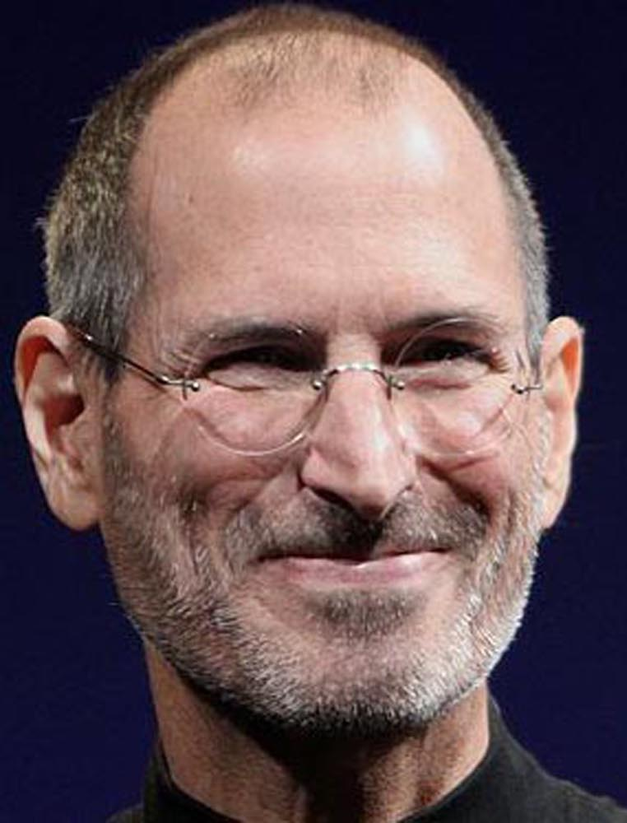
“When people hear the word open, they think Windows”
-Steve Jobs, October 2010
Notes:
http://infoworld.com/t/mobile-platforms/windows-open-in-steve-jobs-world-168
We couldn’t have said it better ourselves!

Slide 9
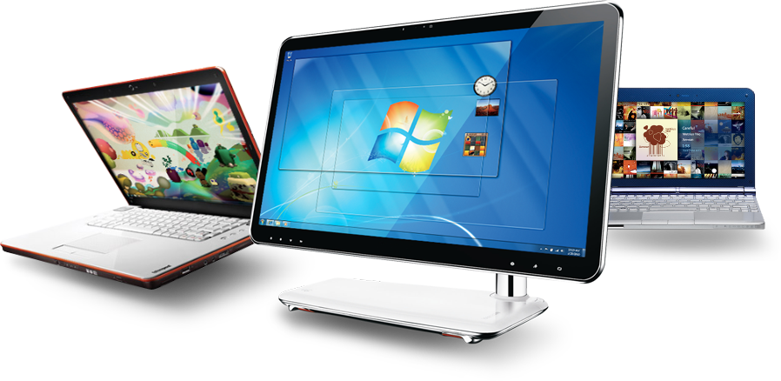
Windows 7
Глубокая интеграция и поддержка индустриальных стандартов
Web Browsing
Storage and File Systems
Networking and Devices
CSS
ECMAScript
HTM
MIME
WSDL
XML
ATAPI
CIFS
iSCSI
SATA
SCSI
802.1x
Bluetooth
BOOTP
DHCP
DLNA
DNS
Ethernet
FTP
HTTP
IEEE 1394
IKE
IPP
IPSEC
IPv4
IPv6
IPX/SPX
IRDA
Kerberos
L2TP
LDAP
NETBEUI
Postscript
PPP
PPTP
Radius
RTP
SOAP
SSL/TLS
TCP
Teredo
UPnP
WiFi
WS-Security
Bus, Power Management
Data, Image, Video, Audio, and Font Formats
ACPI
CIM
PCI
PCMCIA
SNMP
USB
WS – Mgmt
GIF
JPEG
JPEG XR
MP3
MPEG4
OpenFont
OpenType
TrueType
Unicode
Notes:
< Note to Presenter : Feel free to cut the list and highlight the technologies more relevant to your location/ situation>
Behind the ongoing momentum of Windows 7 is strong support for industry standards. This represents an enormous investment to ensure that standards are deeply integrated into our testing systems.
The Windows platform represents the broadest ecosystem of developers in the world. There are over four million Windows applications in all, and Windows 7 allows software to become even better. Developers are creating rich applications that take advantage of the standards and new technologies in Windows 7. Microsoft partners have delivered over 800,000 new unique Windows 7 applications exploiting these new technologies with over 240,000 new devices, peripherals, and machines.

Slide 10
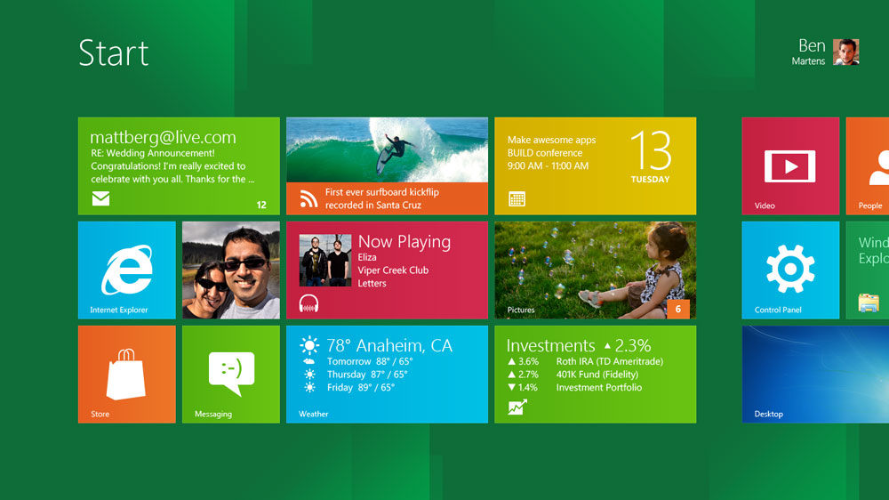
Windows 8 (Consumer Preview)
Используйте web-приложения (HTML5, CSS3 и JavaScript)
Windows 8
IE 10
Windows Phone
Notes:
Timing: 1 minute
Key Points:
Windows 8 builds upon the Windows 7 commitment to standards and interoperability, enabling a Windows experience that is powered by apps that work together and sync across devices, and will work with a new generation of hardware.
Metro style apps are built using your existing skills and can reuse code assets you already have. If you know web development technologies, you can use HTML5, CSS3, and JavaScript.
We updated our accessibility foundation in Windows 8 with support for industry standards. By supporting standards from the Web Accessibility Initiative, Accessible Rich Internet Applications (ARIA), HTML5, and XAML, it is easier for developers to code accessibility into their applications and for the ATs using UI Automation to consume the information that makes accessibility scenarios work on Windows 8.

Slide 11
Windows Live
Поддержка различных стандартов и протоколов для интеграции с социальными сетями и веб-сервисами
Поддержка стандартов :
ActivityStrea.ms
W3C (CSS3, HTML5)
Oauth WRAP
Oexchange
Odata
Portable Contacts
XMPP
>85 веб-сервисов интегрированы с Windows Live Messenger
HTML5 cross-browser support on SkyDrive
Notes:
Timing: 3 minutes
Key Points:
Support for emerging standards enables a more integrated customer experience
Service connections and cross-browser support are two great examples of a “more integrated customer experience”
Script:
It’s not just traditional standards we support, there are an emerging set of formats and protocols for integrating social networks and web services. For example, the new version of Windows Live includes Windows Live Messenger Connect, which uses these protocols to aggregate data from multiple sources – more than 85 in all – while enabling the user to control personal information that appears across the different sites. For example, instead of logging in two places, you can now see Facebook feeds within the Windows Live experience. You could start a chat with a friend on Yahoo Messenger, Facebook chat, etc. all within the Windows Live Messenger interface.
What about those who aren't current Windows Live Messenger users? Good news: Microsoft opened up Messenger to all with its added support for the popular XMPP instant messenger protocol, an open standard. In other words, anyone can build innovative messaging clients – either stand-alone or built into their devices – that include access to Messenger’s 300 million active users.
In the latest SkyDrive release, we introduce introducing drag and drop as a way to upload files and photos for browsers that support HTML5 File API like Internet Explorer 10, Google Chrome, Firefox and Safari. And while your files are uploading, you can continue to browse and use SkyDrive. You no longer have to sit and wait for uploads to complete. We also have worked to make sure that SkyDrive works well on Internet Explorer 10. If you’re using the Windows 8 Developer Preview, you’ll notice that support for CSS3 animations works when you resize an album.
<More detail on standards to reference as needed>
Here are more examples of standards supported in Windows Live Messenger and the ways in which Microsoft was involved:
OAuth WRAP – successor to web resource authorization protocol (actively involved in the development)
Portable Contacts – spec to have users be in control of their own data http://portablecontacts.net/
ActivityStrea.ms – an extension of Atom http://activitystrea.ms/ (actively involved in the development)
Oexchange - – implemented parts of this -- OExchange is an open protocol for sharing any URL with any service on the web – oexchange.org
OData – restful protocol for getting data in and out of a cloud service – http://odata.org (implemented)
All of these standards are implemented with RESTful endpoints that emit data as XML/ATOM/JSON/RSS, enabling easy integration with other applications via modern web technologies.

Slide 12
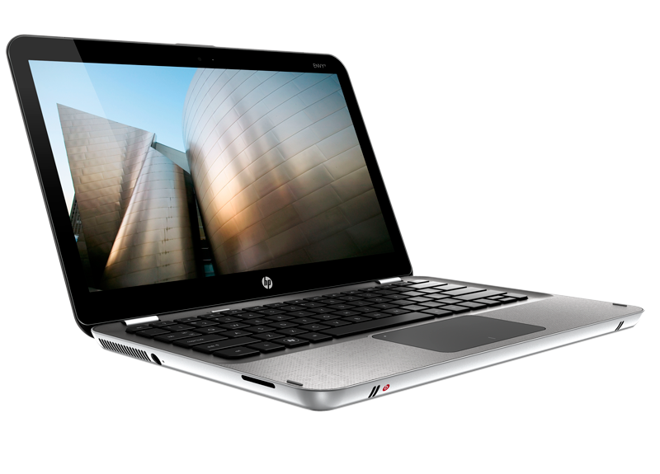
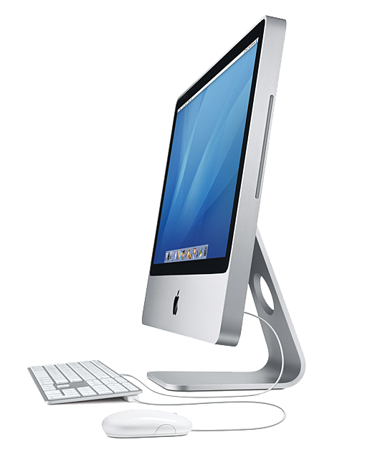
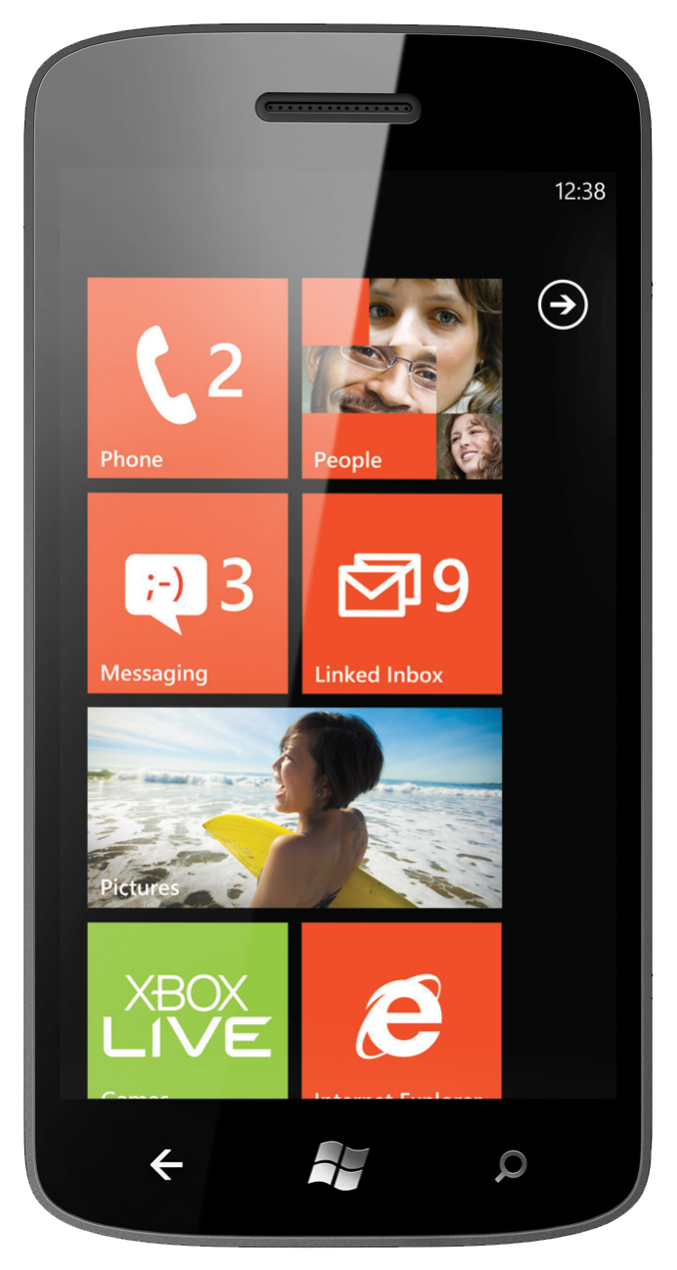
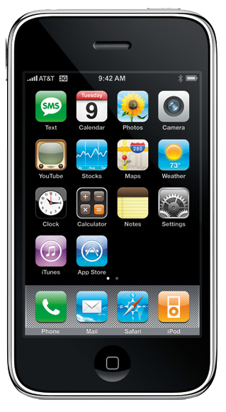
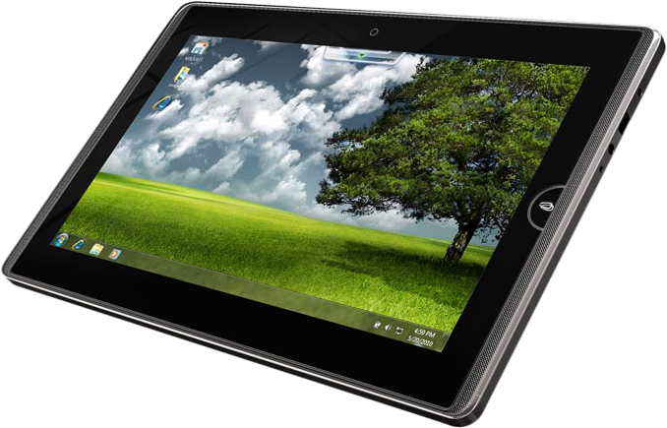
Office 2010 and Office 365
Форматы, интеграция, документация
Office System Standards
Стандарты Open XML, ODF, PDF, HTML
Интеграция другие платформы
Документация ОткрытыеAPIs, форматы файлов и протоколы
Atom
BPMN
DoD 5015
HTML, HTTP, HTTPS, CSS
MathML
SQL/CLI (ODBC)
ODF 1.1 (IS 26300)
Office Open XML (IS 29500) OpenSearch
OpenType
OpenXPS
PDF (IS 32000)
PDF/A
RTF
RSS
SAML
SOAP
SVG
UML
Unicode
URI/URN
W3C XML Schema
WCAG/ATAG/ Section 508
WebDAV
WSDL
XHTML
XML
XML Web Services
XMLDsig/ XAdes
XPath
XSLT
Работает на Windows
И других платформах
Notes:
Майкрософт поддерживает ODF 1.2. Поддержка будет внедрена после прохождения сертификации ISO.
Timing: 3 minutes
Key Points:
Due to commitment to interoperability, standards, and documentation, Office delivers the best productivity experience across operating systems, devices, and productivity scenarios.
Script:
Due to commitment to interoperability, standards, and documentation, Office delivers the best productivity experience across operating systems, devices, and productivity scenarios.
<click to list of standards>
Microsoft Office productivity suite includes strong support for standardized document formats, offering customers greater choice and more flexibility among document formats and creating additional opportunities for developers and competitors. Microsoft Office 2010 includes support for many different document formats, including Open Document Format (ODF) and Open XML. Customers using Office 2010 or Office 2007 SP2 are able to open, edit and save documents using ODF and save documents into the XPS and PDF fixed formats from directly within the application.
Microsoft has published more than 60,000 pages of documentation on protocols and document formats that are supported in Office 2010. We will continue to engage in the standards community on Open XML, ODF, and PDF evolution, and participate in the W3C accessibility working group.
<click to final build (device pictures)>
These commitments to standards, interoperability, and documentation help us not only deliver the best productivity on Windows, but also best-in-class on other devices. A couple examples of how these commitments translate into customer experiences:
Office for Mac is a highly popular and successful program; in fact, it’s one of the best-selling applications for Apple computers. Microsoft’s support for open standards like Open XML makes this possible.
Exchange is a great interoperability example. Exchange ActiveSync is a synchronization protocol that's based on HTTP and XML – which enables mobile phone users to access their e-mail, calendar, contacts, and tasks and to continue to be able to access this information while they're working offline. It is licensed to a number of mobile device companies, including Apple for the iPhone and Google for certain Android smartphones. Exchange ActiveSync technology is also used by other messaging and collaborative software servers, including Novell GroupWise and Lotus Domino.
As we discussed with Windows Live, documentation for open protocols make Office integration with social networks possible and more seamless.
Also, as other devices become increasingly more important in people’s lives—such as the iPhone and iPad, as well as Android-based devices—we’re looking at how we extend the Office platform to them as well. A great example is Lync, which is available for all major smartphone platforms -- iOS, Android, and Windows Phone. In summary, you can see with Office how we’re striving for an open and connected experience whenever possible.

Slide 13
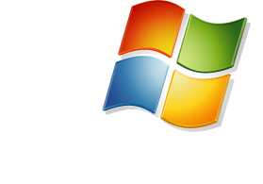
Серверная инфраструктура
Возможность клиентам управлять смешной инфраструктурой
COMMON RUNTIME SUPPORT FOR APPLICATIONS
MySQL/
C/C+
.NET
SUBSYSTEM FOR UNIX APPS
HIGH PERFORMANCE VIRTUALIZATION
Соглашения об интеграции с Novell, Citrix (Xen) и Red Hat
Поддержка других гипервизоров при виртуализации (SVVP)
System Center Operations Manager поддерживает мониторинг: Linux, UNIX, Vmware и др.
Notes:
Windows Server has great support for working with Linux:
Interoperability agreements with Novell, Citrix (Xen), and Red Hat to support Linux on Hyper-V
SVVP (Server Virtualization Validation Program) to certify non-Microsoft Hypervisors for Microsoft Support
System Center Operations Manager supports monitoring of non-Windows, including Linux, Unix & AIX and as many as 400 other platforms with partner and codeplex plugins.
System Center Virtual Machine Manager enables IT staff to manage virtualization products, operating systems and applications from multiple vendors, including Linux and VMware ESX.
As announced at OSBC, we have now extended support to Linux based CentOS. This development enables our hosting partners to consolidate their mixed Windows + Linux infrastructure on Windows Server Hyper-V reducing cost and complexity while better on enterprise class virtualization platform.

Slide 14
Microsoft + Open Source
Notes:
Timing: 2 minutes
Key Points:
We do not compete against open source as a category, we increasingly work collaboratively with this community.
You may be surprised to learn what Microsoft is doing with open source. More and more, customers, partners and the industry understand that the work we are doing with open source is about helping customers and enabling a rich and robust ecosystem of developers and partners.
The following slides will provide some great examples.
Script:
You may be surprised to learn what Microsoft is doing with open source. More and more, customers, partners and the industry understand that the work we are doing with open source is about helping customers and enabling a rich and robust ecosystem of developers and partners. We enable open source on our platforms. We recognize that if we’re going to use open source, then we also have to give back, especially if we want open source developers to continue to think of Windows and Windows Phone as platforms for them to develop on. For example, Windows Azure supports a wide-range of development languages, including Java, PHP and Node.js so that developers can build applications for using any language tool, or framework of their choice – including open source. Let’s review the following slides for some more detailed examples.

Slide 15
Microsoft + Linux
Интеграция с Hyper-V
Разработка приложений под Windows и Linux (CoApp)
“Microsoft is playing quite nicely with Linux and other open source tools. “
-Robert McMillan, Wired Enterprise
Notes:
Timing: 2 minutes
Key Points:
Device Driver Code contributions for Linux: enables better performance of Linux when virtualized with Hyper-V
CoApp: you are developing apps for Linux? Why not make them work on Windows and open up more opportunities for your app to get adopted?
Script:
You may be surprised to learn what we are doing with Linux. We have learned a lot over the past decade. Embracing Linux on our platforms is a real business for us. For example, we work on a variety of interoperability initiatives with Linux vendors -- SUSE, Citrix, RedHat, CentOS -- to provide support for Linux as a “first-class guest” on Hyper-V. Another great example is CoApp, which is an is an open-source package management system for Windows. The goal of the CoApp project is to create a community of developers dedicated to creating a set of tools and processes that enable other open source developers to create and maintain their open source products with Windows as a build target.

Slide 16
Microsoft + Apache Hadoop
Интеграция Hadoop с Windows Server и Windows Azure
Подключение BI-инструментов Microsoft к данным Hadoop
“Microsoft's ongoing relationship in supporting the open source Hadoop technology continues apace as interoperability is being opened up for Windows Server and Windows Azure.“
-Kurt Mackie, Redmondmag.com
Notes:
Timing: 2 minutes
Key Points:
We’re committed to helping customers manage “big data”, working with the Apache Hadoop community to support Hadoop on Windows Server and Windows Azure.
Our Big Data solution is also integrated into the Microsoft BI tools such as SQL Server Analysis Services, Reporting Services and even PowerPivot and Excel. This enables you to do BI on all your data, including those in Hadoop.
Script:
Just ten years ago, most business data was locked up behind big applications. We are now entering an era when unlocking this data and its potential to drive new knowledge and insights is becoming a key success factor for many ventures. To embrace this “Big Data revolution”, last October Microsoft announced plans to deliver enterprise class Apache Hadoop based solutions on both Windows Server and Windows Azure as part of Microsoft’s “big data” roadmap. Since we’ve launched two limited customer previews of the Apache Hadoop based distribution, which enables Hadoop apps to be deployed in hours instead of days. Customers such as Webtrends and the University of Dundee have been using the service to glean simple, actionable insights from complex data sets hosted in the cloud.
There is also innovative work being done both at Microsoft and with members of the Apache Hadoop community to help customers unleash the value of their data by allowing more users to derive insights, combining and refining data regardless of its scale and complexity. Our Big Data solution is integrated into the Microsoft BI tools such as SQL Server Analysis Services, Reporting Services and even PowerPivot and Excel. This enables you to do BI on all your data, including those in Hadoop.

Slide 17
Microsoft + PHP/Java
PHP и Java на Windows Server и Windows Azure
Windows Azure plug-in for Eclipse
“Between 2003 and 2012 we've seen the general opinion about Microsoft, Windows and PHP turn 180 degrees.“
-René de Haas, SoHosted CEO
Notes:
Timing: 2 minutes
Key Points:
Great example of how far the Linux experience has evolved over the past several years – from no PHP experience on Windows to PHP running extremely well and with high performance on both Windows and Linux.
PHP releases now include support for both Windows and Linux.
Script:
Over the past several years, Microsoft and its partners have worked diligently with the PHP community to improve the experience PHP developers and users have on Windows Server and Windows Azure. Now the PHP community supports Windows right alongside Linux, including the recent release of PHP 5.4.0. René de Haas, CEO of a Dutch webhosting company called SoHosted, is a partner who has been instrumental in improving the PHP on Windows experience. According to René, “Between 2003 and 2012 we've seen the general opinion about Microsoft, Windows and PHP turn 180 degrees” due to the improvements made.

Slide 18
Мы не конкурируем с СПО
загрузок
За год количество СПО-приложений на Windows выросло на 400%
Microsoft
WebMatrix
350,000⁺
80,000
23/25
2009
2010
23 из 25 наиболее популярных СПО-проектов поддерживает работу на Windows
28,000 СПО-проектов
300,000+ пользователей
>1M
Source: Geeknet
Notes:
Timing: 3 minutes
Key Points:
The substantial growth of OSS on Windows, more than 400% in one year, illustrates the momentum of Microsoft + Open Source
Codeplex, Microsoft’s open source project community has 28,000+ open source projects
In January 2011 Microsoft launched WebMatrix -- a free, light-weight web development tool designed for quick web site building and deployment. This tool puts open source tools at developers’ fingertips and these developers have downloaded more than one million open source web applications.
Script:
Our increased commitment to working with open source has sparked tremendous momentum and contributed to rapid growth of open source software on Windows – in a single year, the number of OS apps running on Windows grew 400% (from 80,000 in 2009 to 350,000 in 2010), with 23 of the top 25 OSS projects run on Windows. Codeplex, Microsoft’s open source project community has grown to more than 28,000 open source projects and more than 300,000 registered users. Another great example is Webmatrix, a free, light-weight web development tool designed for quick web site building and deployment. This tool puts open source tools at developers’ fingertips and these developers have downloaded more than one million open source web applications. Since it’s launch in January 2011, there have been more than 1 million downloads.

Slide 19
СПО в Microsoft Research
Зачем это Майкрософт?
Являясь платформенной компанией мы хотим предоставить средства для исследований и разработки новых продуктов под нашу платформу. Мы верим, что СПО – прекрасный механизм для этой цели.
СПО проекты Microsoft Research
Abstract State Machine Language (Asml)
Boogie
Chemistry Add-in for Word
CHESS
Common Compiler Infrastructure (CCI)
Computational Biology Tools
Conference XP
Creative Commons Add-in for Office
Environmental Scenario Search Engine (ESSE)
ESSE Visualization Plugin for NASA
World Wind
Gene Pattern Add-in for Word
Goblin XNA
HD View SL
Microsoft Biology Foundation
Microsoft eScience Excel Tools
Microsoft .NET Gadgeter
Microsoft Research Biology Extension for Excel
NETCDF Library for .NET
NodeXL
Ontology Add-in for Word
Pex and Moles Open Source Add-ons
Practical Parallel and Concurrent Programming
Randoop
Research Information Center
RNA Comparative Analysis Software Tools
Scientific Dataset
Scientific Workflow Workbench
Sciscope
Singularity
Spec#
VCC
WikiBhasha
WPF Dynamic Data Display
Notes:
Microsoft Research has been making significant contributions to OSS projects giving researchers and developers the tools they need for better solutions.

Slide 20
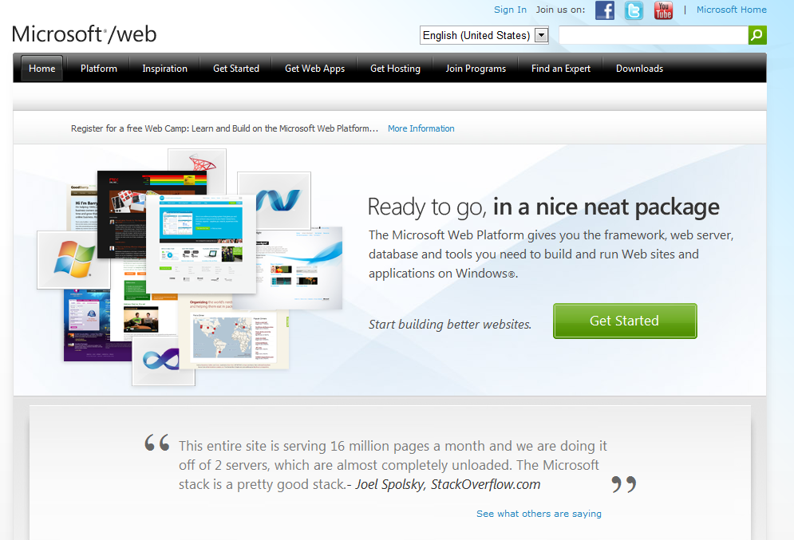
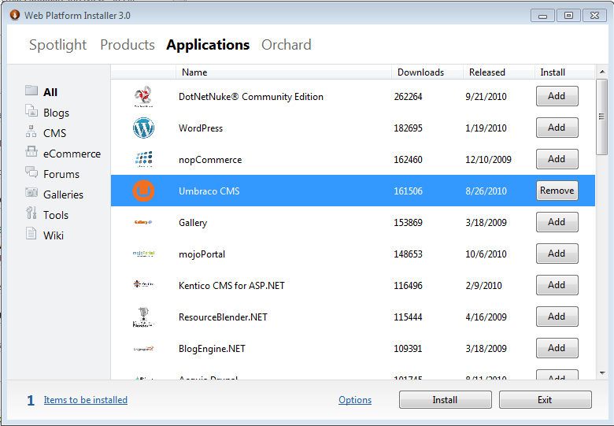
Microsoft.com/web
Making it simple to develop, deploy, and run web applications on Windows – including open source
Microsoft Web Platform Installer
Easily install free ASP.NET and PHP web apps for blogging and content management
Over 2 million downloads since launch in Jan 2010
Offers over 70 Web Platform Products
Notes:
Developers and IT Pros can now download and install popular OSS projects from Microsoft.com such as ASP.NET and PHP web blogging and content management applications including DotNetNuke, Joomla!, and SilverStripe, onto Windows with just one or two clicks for free. Its called the Web platform Installer.
Install the latest versions of FREE Microsoft Web Platform tools, web server and extensions, database and frameworks including PHP.
Easily install popular ASP.NET and PHP web apps from the community (and their dependencies).
Since January 2010 the Web PI itself has been downloaded over 2 million times. For each install of Web PI a customer downloads, on average, 5 Web Platform products (SQL Express, Visual Web Developer, etc.).
Web PI offers over 70 Web Platform Products.
25 applications are offered in Web PI that have resulted in over 1.3 Million application downloads.
Makes it simple for anyone using Windows Server or Client to design, develop, discover, deploy and run web applications.

Slide 21
Codeplex.com
Microsoft’s Open Source project hosting site
10,000+ Open Source extensions
3,000 Open Source plug-ins for Windows
160,000+ registered users
3 million visitors/month
Notes:
CodePlex.com, is our own open source project hosting web site, and has over 10,000 open source extensions and plug-ins for Microsoft server products, 3000 open source extensions or plug-ins for Windows, and thousands of other open source extensions or plug-ins for other Microsoft products such as SQL, SharePoint, Office, and Dynamics CRM. The site also has 160,000 registered users, 10,000 projects, 160 million lines of code published, and 3 million visitors per month.

Slide 22
Windows Azure
Приложения
Привычный язык и среды разработки
Windows Azure Command-line Tool for
Tools for Windows Azure
Windows Azure SDKs
AppFabric SDKs
http://
oData
XML
AtomPub
REST
RSS
Web Services
Runtimes &
Services
Notes:
Windows Azure is a great example to our approach to openness in the Cloud. Developers can build Azure application in Java, PHP,. and .Net. They can access Azure services for compute, storage, security, integration, directory, etc. form a variety of open protocols.
You may want to reference the TechNet radio interview with Mel Beckman, the blogger who famously said “I don’t do Windows” and why he is a fan of Azure.
http://edge.technet.com/Media/TechNet-Radio-Windows-Azure-A-Non-Microsoft-Perspective/

Slide 23
Спасибо
Leonid.Anikin@microsoft.com web: microsoft.com/openness blog: openness@microsoft

Slide 24
© 2011 Microsoft Corporation. All rights reserved. Microsoft, Windows, Windows Vista and other product names are or may be registered trademarks and/or trademarks in the U.S. and/or other countries.
The information herein is for informational purposes only and represents the current view of Microsoft Corporation as of the date of this presentation. Because Microsoft must respond to changing market conditions, it should not be interpreted to be a commitment on the part of Microsoft, and Microsoft cannot guarantee the accuracy of any information provided after the date of this presentation. MICROSOFT MAKES NO WARRANTIES, EXPRESS, IMPLIED OR STATUTORY, AS TO THE INFORMATION IN THIS PRESENTATION.

Slide 25
Facts and Figures
700,000+
For every
$350,000+
$1
Microsoft Partners worldwide
of Microsoft revenue,
partners earn
Open Source applications run on Microsoft platforms
$8.70
Microsoft cloud services are used by
Microsoft is involved with
150+
20 million businesses
Standards Organizations
Microsoft’s BizSpark program has helped more than
and more than
$537 billion
1 billion people
40,000 entrepreneurs
worldwide
Revenue that the Microsoft ecosystem collectively generated
and early-stage startups with software and connections to over 2,000 partners

