Slide 1




Открытые технологии Microsoft
Ross Gardler
Senior Technology Evangelist
MS Open Technologies
Leonid Anikin
Open Source Strategies Lead
Microsoft Russia
Notes:
< Note to Presenter: Please add your name and email address as appropriate >
Presenter Guidance:
This presentation provides a sample script; however, we strongly recommend that you learn the script content as a way to tell the story and then rely on the key points to guide your discussion.
Slide timing is approximate and should be considered a guide only.
© 2011 Microsoft Corporation. All rights reserved.
This presentation is for informational purposes only. Microsoft makes no warranties, express or implied, in this summary.

Slide 2


Мы изменили компанию и стали более ОТКРЫТЫМИ
Notes:
<choose from slides 3 – 10 as alternative intro pictures>
Timing: 1 minute
Key Points:
Microsoft has changed as a company and become more open.
Script:
Microsoft has changed as a company and become more open. The old debate – black or white; open source or commercial software; us versus them – is simply no longer relevant. Today, many customers manage mixed IT environments. And they have told us that what matters today is maximizing their existing IT investments while having the freedom to choose new solutions that best support their business goals. To meet these customer needs, Microsoft is committed to openness.

Slide 3
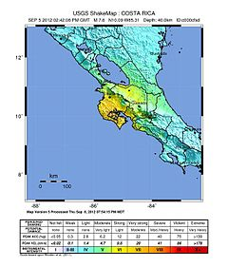
Коста-Рика, 8:42, 5 сентября 2012
Землетрясение 7.6 балов. Нехватка информации
3x рост
Интернет-трафика у Teletica.com
Тихоокеанский центр предупреждения цунами сообщил о возможности цунами на большинстве побережья Центральной и Южной Америк.
Предупреждение о цунами
“Мы не могли передавать срочные новости, могли намного меньше взаимодействовать с людьми. Нам было нужно решение незамедлительно” - Luis Zarnowski, Interactive Media Manager, Teletica
525M
Notes:
Case study from http://www.microsoft.com/casestudies/Windows-Azure/Teletica/In-Costa-Rican-Earthquake-Aftermath-Microsoft-Windows-Azure-Provides-Fast-Scalable-Interoperable-Solution-for-Web-Traffic-Surge/710000001977
Teletica In Costa Rican Earthquake Aftermath, Microsoft Windows Azure Provides Fast, Scalable, Interoperable Solution for Web Traffic Surge
Business Situation
September 5, 2012 was just another Wednesday in Costa Rica until a natural disaster struck violently and without warning. At 8:42 a.m., a 7.6 magnitude earthquake wreaked widespread havoc on this picturesque Central American nation of 4.3 million, severely damaging buildings and infrastructure, and claiming the lives of two people. Teletica, the Costa Rican communications conglomerate that owns and operates one of the country’s oldest and most popular television stations, became a key information resource as a dazed nation confronted the aftermath of the disaster.
Just minutes after the earthquake struck, the station’s web outlet, Teletica.com, received over three times its normal traffic due to people within and outside of the country seeking information on what happened to the nation, their loved ones, and their friends.
"We quickly realized that we were overwhelmed by user traffic and that we were unable to inform or interact with those seeking information,” said Luis Zarnowski, Interactive Media Manager at Teletica. “Prior to the quake, Teletica.com averaged about 32,000 daily visitors, but within minutes of the catastrophe, we had over 100,000 users and the site went down.”
Despite efforts by its in-house IT staff to apply quick fixes and code changes to bring the website back up, Teletica’s engineers were unsuccessful. “We couldn’t report breaking news, much less interact with our users, and we needed an immediate solution,” said Zarnowski. “That’s when we called Microsoft.”
Image is in the public domain because it contains materials that originally came from the United States Geological Survey, an agency of the United States Department of the Interior. For more information, see the official USGS copyright policy Retrieved from http://en.wikipedia.org/wiki/2012_Costa_Rica_earthquake

Slide 4
Решение: Windows Azure
Открытое и гибкое облачное решение
Интерактивная, наполняемая пользователями, в режиме реального времени
Создать
Распространение контента по всему миру из датацентров Microsoft
Карта
“смогли поднять наш веб-сайт с сильно возросшим трафиком и новыми приложениями всего за 45 минут” -
Zarnowski , Teletica
Глобальное покрытие
Последние новости и видео пользователей
Потоковые
данные
Развернуть
Notes:
Solution
Microsoft Windows Azure quickly was recognized as the ideal solution to bring Teletica.com back online. Windows Azure is an open and flexible cloud platform that enables users to quickly build, deploy and manage applications across a global network of Microsoft-managed datacenters. Applications can be built using any language, tool or framework.
Teletica decided that an interactive map for Costa Ricans to upload photos and real-time information about what was happening across the country was critical for the site. But how would Teletica host and deploy such a tool, when they intended to build it with open source technology? As requirements were quickly defined, scalability, interoperability, and the ability to stream webcasts were paramount, so the Windows Azure platform was a clear choice.
“We called Microsoft to see if our users would be able to easily upload pictures, video, and commentary from different areas of the country using a mash up with Google maps, and the answer was a resounding yes,” said Zarnowski. “By using the Windows Azure platform, not only were we able to reliably host our website with its high volume traffic, we were also able to deploy the application our users so desperately needed in about 45 minutes.”
“In the specific case of the earthquake in Costa Rica, the relationship we had already set up with Teletica gave us a very good reaction time, because within minutes, we were able to put the services in place that they wanted to launch for their readers, using a cloud platform,” said Yuri Porras, Director of New Technology, Microsoft Costa Rica. “The idea of interoperability was a fundamental factor here because the applications they had were open source, but that was no obstacle for us. We were able to react very quickly and put this service at the clients’ disposal using Windows Azure technology,” Porras added.
Benefits
For Teletica, Microsoft Windows Azure was the best platform for the rapid development and deployment of its interactive map application.
Once its hybrid application was deployed on the Windows Azure platform, Teletica was able to easily change its “Instance Count” while almost effortlessly scaling its web services to meet any level of demand. The virtually unlimited cloud-based storage capacity of Windows Azure also meant that Teletica’s users could upload all of the pictures, video and text they wanted with no negative ramifications.
Through its rapid deployment of the interactive map application running on Microsoft Windows Azure, Teletica set a global benchmark for news reporting in a time of crisis. People within and outside of Costa Rica used the application to efficiently report and monitor ongoing disaster-oriented events in real time.
Teletica’s post-earthquake experience became a powerful reaffirmation of the importance of having a trusted web technology partner like Microsoft, with experience in cloud services.
“The earthquake showed us that we needed the infrastructure to react quickly to events,” said Zarnowski. “With Windows Azure, we now have the ability to expand capacity quickly and to add servers according to user demands. In a time of crisis, Azure allowed us to efficiently accomodate the sudden upsurge in traffic we experienced, and it allowed us to host the open source application we required.”
To learn more about Microsoft, visit www.microsoft.com
To learn more about Microsoft Openness, visit www.microsoft.com/openness
To learn more about the Windows Azure platform, visit www.windowsazure.com
To learn more about Teletica, visit www.teletica.com

Slide 5

К тому же это было СПО
“Интероперабильность –была ключевым фактором в этом проекте, так как сайт был создан на СПО-технологиях, но это не стало проблемой для Microsoft,” Yuri Poras, Director of New Technology, Microsoft Costa Rica

Slide 6
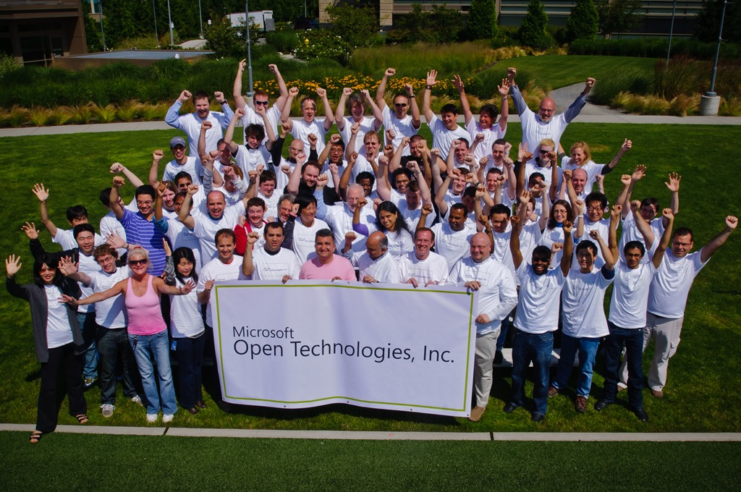
MS Open Technologies
Подразделение Microsoft
Открытость
Интероперабельность
Открытый код
Открытые стандарты
Ross Gardler
15 лет на СПО-рынке
Senior Technology Evangelist, Microsoft
Executive Vice President, Apache Software Foundation

Slide 7



Инвестиции в стандарты
Использование открытого кода
Интеграция платформы с СПО-решениями
Сотрудничать с другими игроками
Слушать клиентов
Быть открытым в облаке
Notes:
Timing: 2 minutes
Key Points:
Microsoft illustrates a commitment to openness in 3 key ways: playing well with others; listening to customers; openness in the cloud.
We "play well with others” by investing in standards, supporting interoperability with open source, and supporting open source on our platforms.
Script:
There are 3 ways in which we demonstrate our commitment to openness:
We work hard as a company to play well with others through investments in standards and support for open source.
We listen to our customers – we want to build innovative new solutions that combine Microsoft and non-Microsoft technologies in an easy and cost effective way.
And we’re open in the cloud. As we make the transition to cloud computing, we're going to do so in an open manner. Specifically, developers who build solutions for our cloud platform can do so in Java, PHP, Node.js and with other open source tools – meaning they can take their best skills on any OS and apply those to Microsoft's cloud platform.
< On Click>
Let’s start with how we play well with others with regards to interoperability, standards, and open source for the benefit of customers and the industry.

Slide 8






Инвестиции в стандарты
более 150 стандартизующих организаций
И более 400 рабочих групп
Notes:
Timing: 2 minutes
Key Points:
Microsoft actively participates and significantly invests in standards efforts worldwide.
Script:
Our goal is simple. We want to enable our customers to pick up a device or use their computer and simply know that it will work the way they want it to.
To achieve this goal, investing in standards is essential. Microsoft actively participates and invests in standards efforts worldwide. We view standards as an important tool to foster interoperability among products and services from different companies, and have a long history of supporting the standards our customers need. We continue to support standards we first engaged with 20+ years ago, and we help develop and support new and emerging standards as the market evolves.
We are formal members in more than 150 standards organizations and more than 400 working groups.
<Definitions of standards organizations listed on the slide; reference as needed>
W3C: W3C standards define an Open Web Platform for application development that has the unprecedented potential to enable developers to build rich interactive experiences, powered by vast data stores, that are available on any device. Although the boundaries of the platform continue to evolve, industry leaders speak nearly in unison about how HTML5 will be the cornerstone for this platform. But the full strength of the platform relies on many more technologies that W3C and its partners are creating, including CSS3, SVG, WOFF, the Semantic Web stack, XML, and a variety of APIs.
Internet Engineering Task Force (IETF): develops and promotes Internet standards, cooperating closely with the W3C and ISO/IEC standards bodies and dealing in particular with standards of the TCP/IP and Internet protocol suite.
OASIS: OASIS is the Organization for the Advancement of Structured Information Standards, a not-for-profit, international consortium that drives the development, convergence and adoption of open standards for the global information society. OASIS members have developed >80 standards to date. The most widely adopted ones include BPEL, CAP, DITA, DocBook, ebXML (ISO 15000), EDXL, OpenDocument Format (ISO 26300), SAML, UDDI, WS-Security, and XACML.
IEEE Standards Organization: IEEE (pronounced "Eye-triple-E“) stands for the Institute of Electrical and Electronics Engineers. The standards arms, IEE-SA collaborates with thought leaders in >160 countries and is a leading consensus-building organization that enables the creation and expansion of international markets, and helps protect health and public safety.
OMA: the Open Mobile Alliance is designed to be the center of mobile service enabler specification work, helping the creation of interoperable services across countries, operators and mobile terminals that will meet the needs of the user. To grow the mobile market, the companies supporting the Open Mobile Alliance will work towards stimulating the fast and wide adoption of a variety of new, enhanced mobile information, communication and entertainment services.

Slide 9







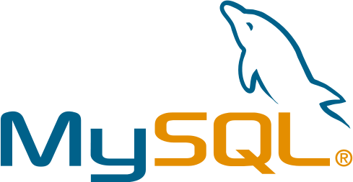
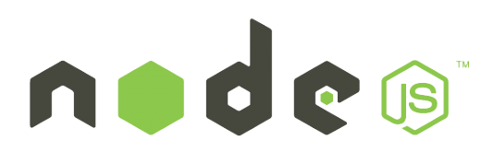




Windows + Open Source
Notes:
Timing: 2 minutes
Key Points:
We do not compete against open source as a category, we increasingly work collaboratively with this community.
You may be surprised to learn what Microsoft is doing with open source. More and more, customers, partners and the industry understand that the work we are doing with open source is about helping customers and enabling a rich and robust ecosystem of developers and partners.
The following slides will provide some great examples.
Script:
You may be surprised to learn what Microsoft is doing with open source. More and more, customers, partners and the industry understand that the work we are doing with open source is about helping customers and enabling a rich and robust ecosystem of developers and partners. We enable open source on our platforms. We recognize that if we’re going to use open source, then we also have to give back, especially if we want open source developers to continue to think of Windows and Windows Phone as platforms for them to develop on. For example, Windows Azure supports a wide-range of development languages, including Java, PHP and Node.js so that developers can build applications for using any language tool, or framework of their choice – including open source. Let’s review the following slides for some more detailed examples.

Slide 10
Microsoft + Linux
Linux runs as a first-class guest on Windows Server Hyper-V
Develop apps for both Linux and Windows (CoApp)
“Microsoft is playing quite nicely with Linux and other open source tools. “
-Robert McMillan, Wired Enterprise
Notes:
Timing: 2 minutes
Key Points:
Device Driver Code contributions for Linux: enables better performance of Linux when virtualized with Hyper-V
CoApp: you are developing apps for Linux? Why not make them work on Windows and open up more opportunities for your app to get adopted?
Windows Azure Virtual Machines enables customers to run both their existing Windows and Linux-based applications in the cloud. Compatible operating systems/images include CentOS, openSUSE, SUSE Linux Enterprise Server, Ubuntu, as well as Windows Server.
Script:
You may be surprised to learn what we are doing with Linux. We have learned a lot over the past decade. Embracing Linux on our platforms is a real business for us. For example, we work on a variety of interoperability initiatives with Linux vendors -- SUSE, Citrix, RedHat, CentOS -- to provide support for Linux as a “first-class guest” on Hyper-V. Another great example is CoApp, which is an is an open-source package management system for Windows. The goal of the CoApp project is to create a community of developers dedicated to creating a set of tools and processes that enable other open source developers to create and maintain their open source products with Windows as a build target. Further, with Windows Azure Virtual Machines, customers can run both their existing Windows and Linux-based applications in the cloud. Compatible operating systems/images include CentOS, openSUSE, SUSE Linux Enterprise Server, Ubuntu, and Windows Server, further illustrating Microsoft’s commitment to openness for customers and partners.

Slide 11
Эффективность уже сделанных вложений в ИТ
Управление смешанными средами
Сотрудничать с другими игроками
Слушать клиентов
Быть открытым в облаке
Notes:
Timing: 1 minute
Key Points:
The second way we demonstrate our openness is by listening to our customers.
Script:
Now lets transition over to a discussion about how we’ve listened to customers to better meet their needs in mixed IT environments, making it easier and less costly for customers to manage their IT environments.

Slide 12
Ставка на облако
Выбор между частным и публичным облаком
Windows Azure
Сотрудничать с другими игроками
Слушать клиентов
Быть открытым в облаке
Notes:
Timing: 2 minutes
Key Points:
In the cloud, openness is paramount.
We’re ensuring an open platform to take advantage of the transformative innovations enabled by the cloud.
Script:
Finally, let’s move the discussion to the cloud. In the cloud, openness is paramount. Microsoft is leading the way to cloud computing with a unique combination of technology, expertise, and an unrivaled ecosystem of partners. Microsoft’s comprehensive set of cloud computing solutions span the platform, application, and infrastructure layers, giving customers the ability to transition to the cloud on their terms. The following slides will provide some more detail.

Slide 13









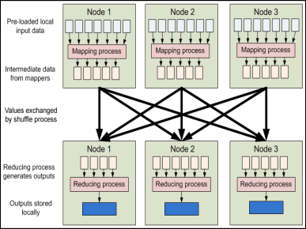


Windows Azure
Гибкость и открытость
Широкий выбор языков и средств разработки: .NET, Node.js, Java и PHP
Запускайте виртуальные машины Linux в Windows Azure
Популярные СПО-приложение в виде шаблонов для Windows Azure Web Sites
Hadoop от для проектов Big Data
CDN
caching
integration
business
analytics
identity
& security
media
HPC
commerce
compute
data management
networking
cloud services
VMs
websites
SQL
database
noSQL
database
blob
connect
virtual network
traffic manager
Notes:
Timing: 3 minutes
Key Points:
Windows Azure is an open and flexible cloud platform.
Developers can build applications using any language, tool or framework – including open source languages such as PHP, Java, and Node.js, and other open source tools.
Our June 2012 technical preview release, brought support for Linux on Windows Azure Virtual Machines and further support for multiple frameworks and popular open source applications through Windows Azure Web Sites.
Script:
As part of our cloud platform, interoperability is a design-time requirement. Windows Azure is an open and flexible cloud platform that enables customers to quickly build, deploy and manage applications across a global network of Microsoft-managed datacenters. To do it right we know we’ve got to be open. Developers can build applications using any language, tool or framework – including open source languages such as PHP, Java, and Node.js, and other open source tools – which means they can utilize familiar open source skills on Microsoft's cloud platform. Currently features and services in Windows Azure are exposed using open REST protocols. Windows Azure client libraries are available for multiple programming languages and are released under an open source license and hosted on GitHub. As Microsoft continues to provide incremental improvements to Windows Azure, we remain committed to working with developer communities. Other recent interoperability enhancements include: Eclipse Plugin for Java, Mongo DB support, code configuration for hosting Solr/Lucene, Hadoop services preview. Also, our June 2012 technical preview brought support for Linux on Windows Azure Virtual Machines and further support for multiple frameworks and popular open source applications through Windows Azure Web Sites – the next two slides provide more details on these services.

Slide 14



Windows Azure. Виртуальные машины
Библиотеки шаблонов (images):
  Windows Server 2008 R2
  Windows Server 2012
  Windows Server 2008 R2 c SQL Server 2008 или 2012
Библиотеки шаблонов (images):
CentOS
openSUSE
  SUSE Linux
  Ubuntu
Notes:
Timing: 1 minute
Key Points:
Windows Azure Virtual Machines allow you to easily move your applications and infrastructure back and forth from on-premises to the cloud without requiring any changes to the existing code.
Customers can run both their existing Windows and Linux-based applications in the cloud. Compatible operating systems/images include CentOS, openSUSE, SUSE Linux Enterprise Server, Ubuntu, and Windows Server, further illustrating Microsoft’s commitment to openness for customers and partners.
Script:
Windows Azure Virtual Machines allow you to easily move your applications and infrastructure back and forth from on-premises to the cloud without requiring any changes to the existing code. Customers can run both their existing Windows and Linux-based applications in the cloud. Compatible operating systems and images available in the online gallery now include CentOS, openSUSE, SUSE Linux Enterprise Server, Ubuntu, and Windows Server, further illustrating Microsoft’s commitment to openness for customers and partners.

Slide 15
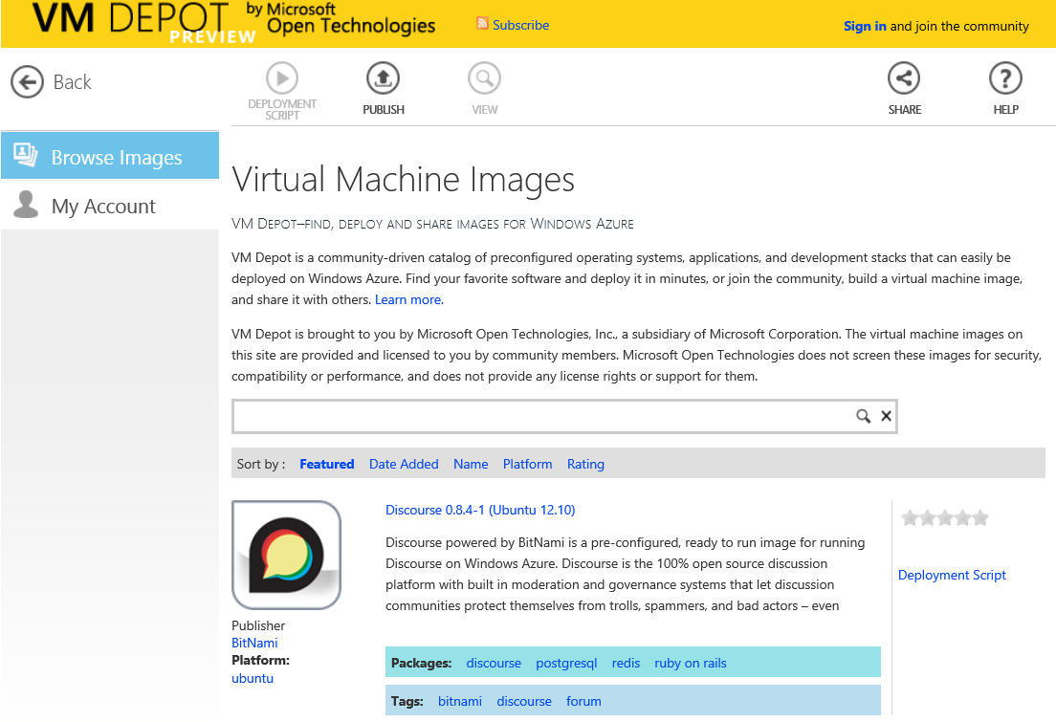
  VM Depot
  Библиотека готовых виртуальных машин с наиболее популярными СПО-приложениями.
  Загрузите свой проект!

Slide 16
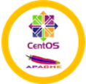
















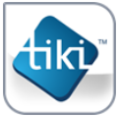























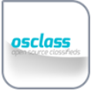






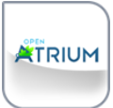



Notes:
Nearing 200 unique images today
7 different variants of Linux (not limited to the supported distributions)
Developer tools and stacks
End user applications
Infrastructure

Slide 17
Демонстрация
Notes:
We are going to look at a few case studies
Building a site like the Teletica one in a few minutes
First demo uses Coppermine from VM Depot to create a video and photo upload site
Site is up and running in just a few minutes
Now need to add branding etc. and you can go live
HD Insights (Apache Hadoop) in a Mixed IT environment
Colombian Government open data

Slide 18
Создадим сайт для обмена видео-роликами и фотографиями.
Развертываем готовое СПО веб-приложение
VM Depot
100% СПО
Ubuntu
Coppermine
Несколько минуты работы
Плюс меняем логотип

Slide 19
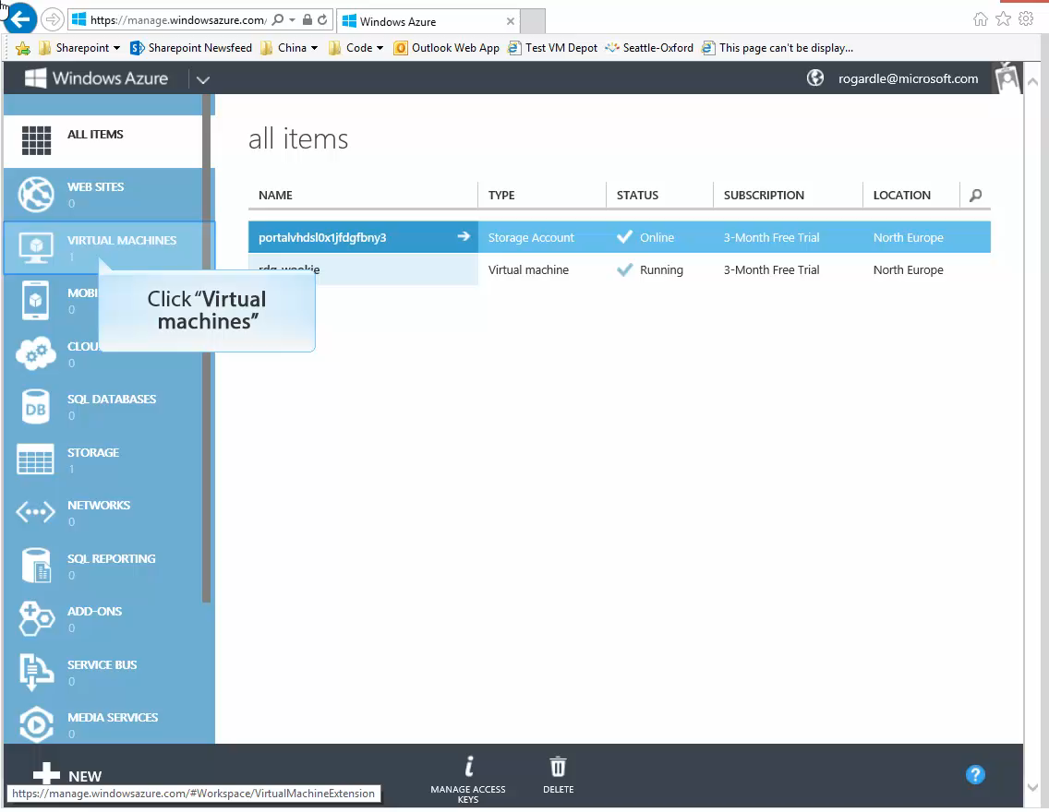
Notes:
Click “Virtual machines”
Select the images page
Select the Browse VM Depot text box
Select the Coppermine 1.5.22-0 (Ubuntu 12.10) text box
Select Next
Open the Image Region dropdown
Select the region you want your VM to be hosted in.
Select Complete
It takes a short while for the image to be copied to your account. Progress is contnually updated here.
You need not stay on this page you can do work elsewhere and watch the indictor in the footer for progress.
Once copying is complete we need to register the VHD, Click the “Register” button.
Select OK
Click the New button
Select the From Gallery text box
Select the My images text box
Select the media-archive-demo text box
Select Next
Select the Virtual machine name text box
Press Tab key
Press Tab key
Select Next
Select the DNS name text box
Select Next
Select Complete
Once the virtual machine has been created and booted select the mediaarchiverdg link
Select the Dashboard text box
Press Ctrl + C key
Select the Address and search using Bing text box
Press Ctrl + V key
Press Enter key
Select the Access my application text box
Select the Login text box
Click the New Tab (Ctrl+T) button
Press Enter key
Select the text box
Press Enter key
Select the Coppermine 1.5.22-0 (Ubuntu 12.10) text box
Select the Login - Your gallery name here tab
Press Tab key
Select the Remember me check box
Select OK
Select the Upload file text box
Click the Open button
Select the demo item
Click the Browse button
Click the Libraries button
Double-click the Videos button
Select the winsat check box
Click the Open button
Select the Home text box
Select winsat.wmv

Slide 20
Смешанная ИТ-инфраструктура с Azure Services
Windows Azure HD Insight (Apache Hadoop)
SQL Server 2012

Slide 21
Microsoft + Apache Hadoop
Революция Big Data. Hadoop на Windows Server и Windows Azure
Интеграция данных их Hadoop с BI-средствами Microsoft
“Продолжающееся сотрудничество Microsoft в поддержке Hadoop и интереоперабильности делают открытыми для него Windows Server и Windows Azure.“
-Kurt Mackie, Redmondmag.com
Notes:
Timing: 2 minutes
Key Points:
We’re committed to helping customers manage “big data”, working with the Apache Hadoop community to support Hadoop on Windows Server and Windows Azure.
Our Big Data solution is also integrated into the Microsoft BI tools such as SQL Server Analysis Services, Reporting Services and even PowerPivot and Excel. This enables you to do BI on all your data, including those in Hadoop.
Script:
Just ten years ago, most business data was locked up behind big applications. We are now entering an era when unlocking this data and its potential to drive new knowledge and insights is becoming a key success factor for many ventures. To embrace this “Big Data revolution”, last October Microsoft announced plans to deliver enterprise class Apache Hadoop based solutions on both Windows Server and Windows Azure as part of Microsoft’s “big data” roadmap. Since we’ve launched two limited customer previews of the Apache Hadoop based distribution, which enables Hadoop apps to be deployed in hours instead of days. Customers such as Webtrends and the University of Dundee have been using the service to glean simple, actionable insights from complex data sets hosted in the cloud.
There is also innovative work being done both at Microsoft and with members of the Apache Hadoop community to help customers unleash the value of their data by allowing more users to derive insights, combining and refining data regardless of its scale and complexity. Our Big Data solution is integrated into the Microsoft BI tools such as SQL Server Analysis Services, Reporting Services and even PowerPivot and Excel. This enables you to do BI on all your data, including those in Hadoop.

Slide 22

Open Source Big Data and Microsoft SQL Server
Ведущий поставщик ИТ-решений для медецины
Используется 82% National Health Service (NHS) в
Великобритаении (отдалённый аналог страховых компаний по ОМД)
Решение
Смешенное решение в публичном и частном облаке на базе Microsoft SQL Server 2012 и Windows Azure HDInsight Service (Hadoop). Интеграция с BI-средствами Microsoft.
Преимущества
Быстрое развёртывание
Быстрая обработка медицинских данных
Решения на основе обработки большого массива данных
«Это заново изобрело то, как мы будем работать с медицинскими записями в будущем»
– Paul Henderson, Business Intelligence Division Head at Ascribe
Notes:
Case Study: http://www.microsoft.com/casestudies/Case_Study_Detail.aspx?CaseStudyID=710000002092

Slide 23
eGovernment

Slide 24
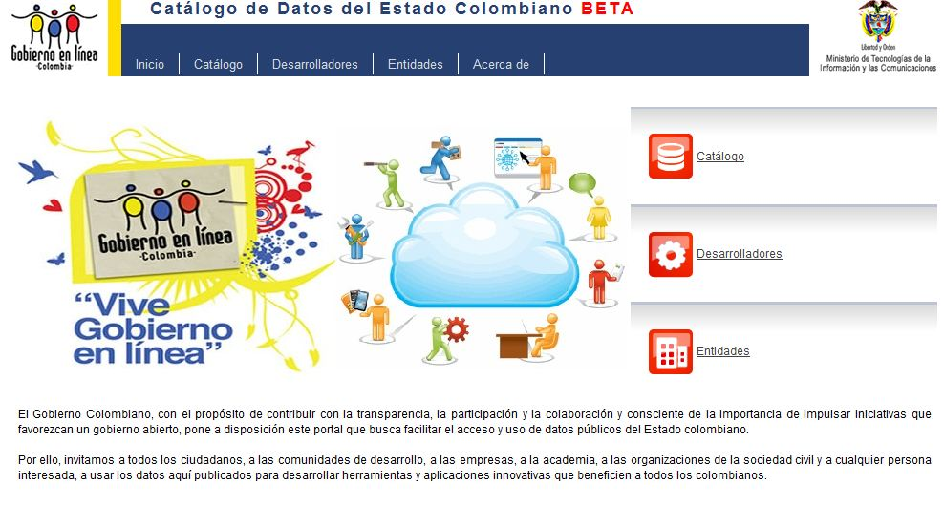
Правительство Колумбии
Open Government и e-Government
Облако
Прозрачность
eGovernment
Аналитика
Достоверность
http://datos.gov.co
Notes:
The Government of Colombia used the Open Government Data Initiative (OGDI) to publish data to demonstrate to citizens of Colombia they were committed to transparency and openness in Government.

Slide 25
Мы изменили компанию и стали более ОТКРЫТЫМИ
Notes:
Microsoft is open
We are working hard on interoperability and supporting open source at all levels of the cloud, IaaS, PaaS and Saas
We are listening to the customers needs and delivering the optimal solution in a mixed IT world.
You decide on what the mix is.

Slide 26
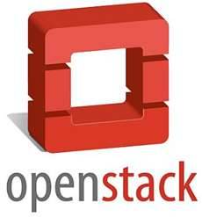
Работа с сообществами
Недавние анонсы
“Это инициатива подтверждает снова и снова обязательство Microsoft работать с различными коммерческими компаниями и сообществами, с целью создания интероперабильных решений в интересах клиентов”
-Sandy Gupta, General Manager, Open Solutions Group
Notes:
<OPTIONAL SLIDE: Customize with local announcements as appropriate>
Timing: 30 seconds
Key Points:
Microsoft is working with the OpenStack community to restore and enhance Windows Server Hyper-V support in OpenStack to benefit customers planning to use the two together.
Script:
In April, the OpenStack community announced the release of Essex. Microsoft is working with the OpenStack community to restore and enhance Windows Server Hyper-V support in OpenStack to benefit customers planning to use the two together. We have put together a dedicated team at Microsoft focused on working with the community to support this effort. Also in April, we participated in the OpenStack Design Summit & Conference. The Microsoft team at the conference was led by Peter Pouliot, who is a known face in the OpenStack community and recently joined Microsoft as community manager for OpenStack. He and others have been working with various community members to investigate the scope of work needed to address Windows Server Hyper-V support in OpenStack. This is all good news for OpenStack and Windows Server Hyper-V customers. This initiative also reiterates Microsoft’s commitment to working with various commercial entities and communities to drive interoperability work for the benefit of customers.

Slide 27

Работа с сообществами
Недавние анонсы
“Мы решили с самого начала, что будем делать код для Hyper-V под BSD-лицензией. Они были готовы поддержать проект и внести код. Как это здорово?!”
-Joe CaraDonna, NetApp Technical Director of Core Operating Systems
Notes:
Timing: 30 seconds
Key Points:
Microsoft is committed to extending support across platforms to the Windows Server Hyper-V solution, making it easier for more customers to realize the benefits of server virtualization and progress toward cloud computing.
Microsoft partnered with NetApp and Citrix to develop FreeBSD drivers (network, storage, and VMBUS) that will allow FreeBSD to run as a first-class guest on the Windows Server Hyper-V hypervisor.
Script:
Recently at at BSDCan, NetApp and Microsoft presented their collaboration with Citrix to bring native support for FreeBSD on the Windows Server Hyper-V hypervisor. This continues a commitment to extend support across platforms to the Windows Server Hyper-V solution, making it easier for more customers to realize the benefits of server virtualization and progress toward cloud computing. For Microsoft the project breaks new ground – it’s the first project in which open source co-development was done with commercial partners like NetApp and Citrix. Also, the FreeBSD community is a new relationship for us relative to other open source communities that we’ve worked with for years. It was invaluable to have partners NetApp and Citrix, both users of and contributors to FreeBSD, be so knowledgeable about how to enable their products to run on Hyper-V with high performance. Given their expertise, they focused their attention mostly on the storage and network aspects of the drivers respectively, but the project was a joint effort in all aspects. Microsoft partnered with Insight Global on developing the VMBUS driver, which is the core that interfaces between the guest operating system and the host Windows Server Hyper-V hypervisor. From the earliest stages the code was intended to be open source, with the goal of incorporating it into the core of FreeBSD. This drove decisions such as using Github as the software development infrastructure.

Slide 28
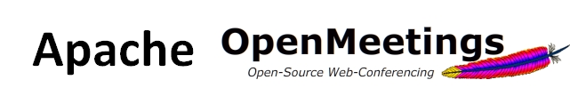

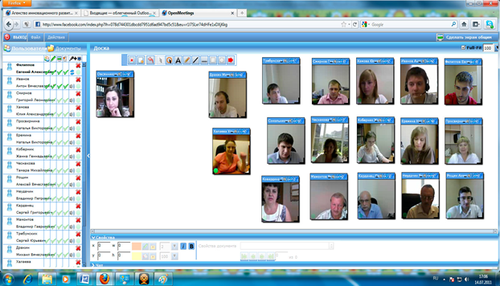
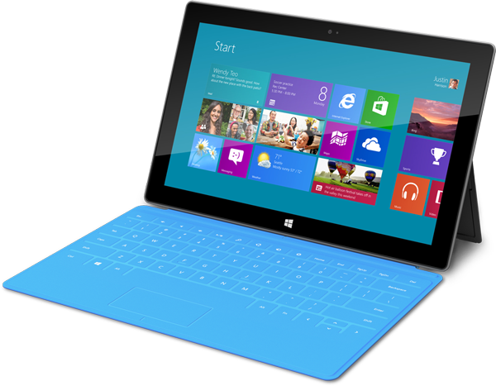


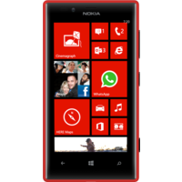

Seeking to work with Local Community
Notes:
Timing: 30 seconds

Slide 29

Add Local Partners
For every $1 Microsoft makes, local partners make $9.25

Slide 30
Спасибо
Leonid.Anikin@microsoft.com

